Slide 1









UGCA Final Project Description Nov 1, 2018
Dr. Anitesh Barua
David Bruton Jr. Centennial Chair Professor of Business
Distinguished Fellow, INFORMS Information Systems Society
Stevens Piper Foundation Professor
University of Texas Distinguished Teaching Professor
Associate Director, Center for Research in e-Commerce
McCombs School of Business, University of Texas at Austin
Email: aniteshb@gmail.com

Slide 2
Topics for UGCA Final Project
You are a consultant to a brand, organization, politician, etc.
Many possibilities for topic selection
E.g.,
Analysis of competing brands or products
Airlines, automobiles, hotels, smartphones, etc.
Track events (e.g., political) or marketing campaigns
Whether social mentions reflect the intended messages
Predict outcomes from social data including images
E.g., box office revenues, crowdfunding success, engagement, etc.
Develop a crowdsourced recommendation system
Provide actionable insights from social mentions using unstructured data analytics
Copyright Anitesh Barua 2018

Slide 3
10 Minute Meetings With Each Group on 11/08
Come up with 2-3 ideas for discussion
Have answers to the following questions:
(i) What is the problem? Why does it matter?
(ii) Likely source(s) of data (must be primary, and not secondary sources like Kaggle)
(iii) What type of analysis will be done?
(iv) What are likely outcomes?

Slide 4
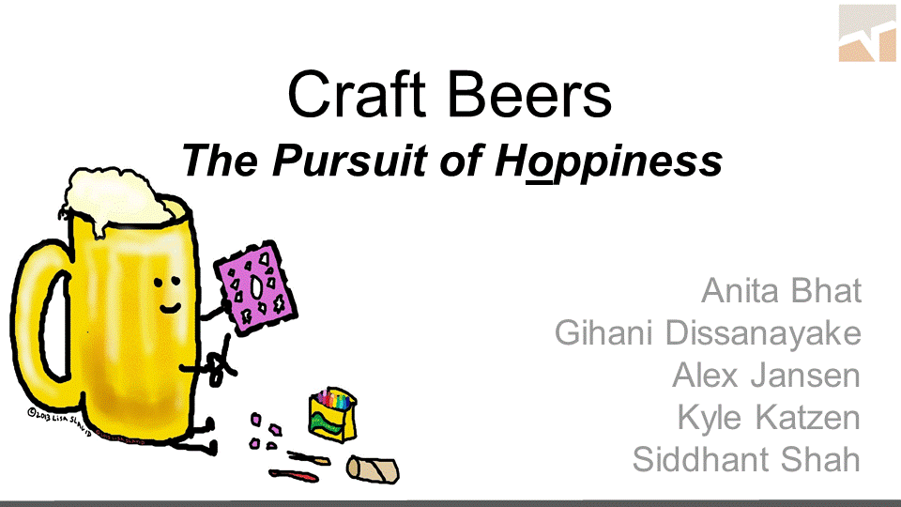
Exemplar Project 1*
*Students in UT Austin’s MSBA program

Slide 5
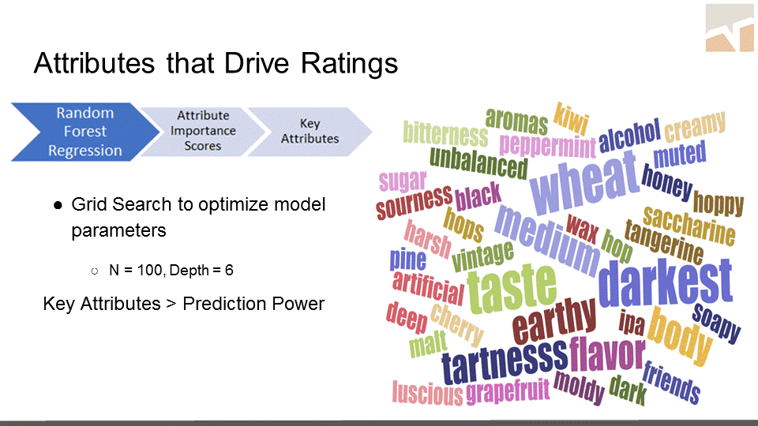

Slide 6
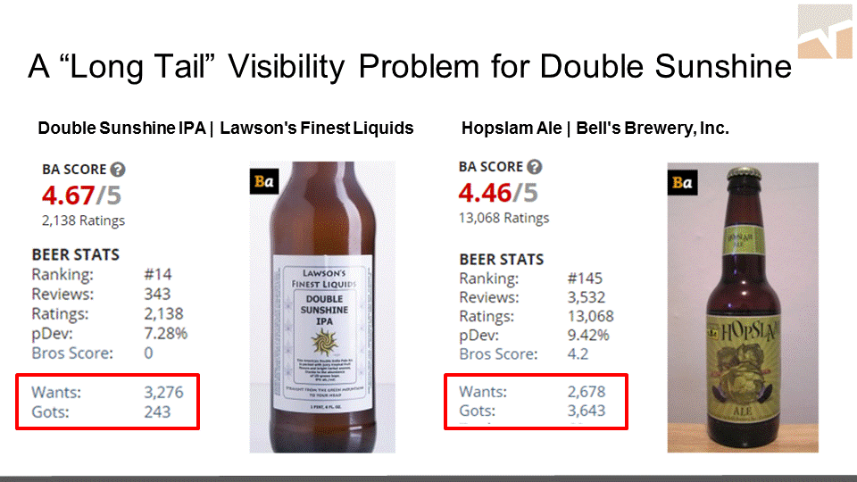

Slide 7
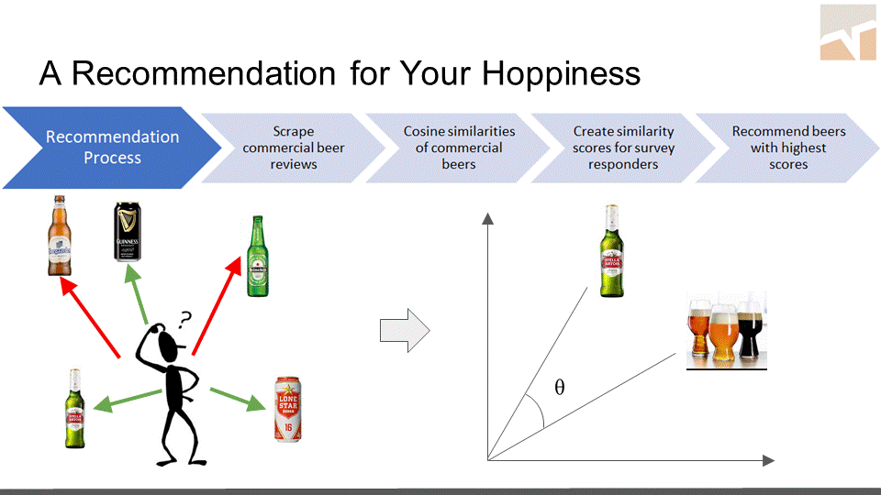

Slide 8

Exemplar Project 2

Slide 9
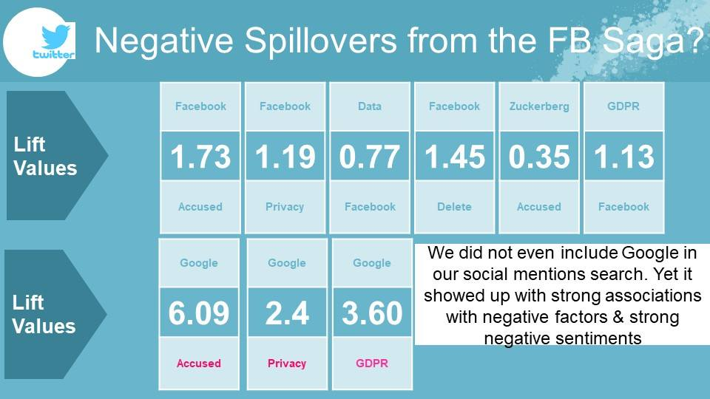
Simple, But Powerful Message

Slide 10
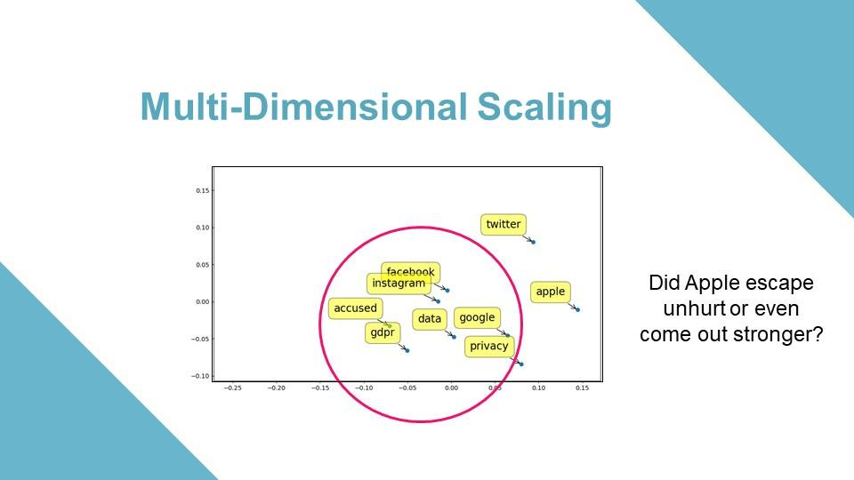
The Aha Moment(s)

Slide 11



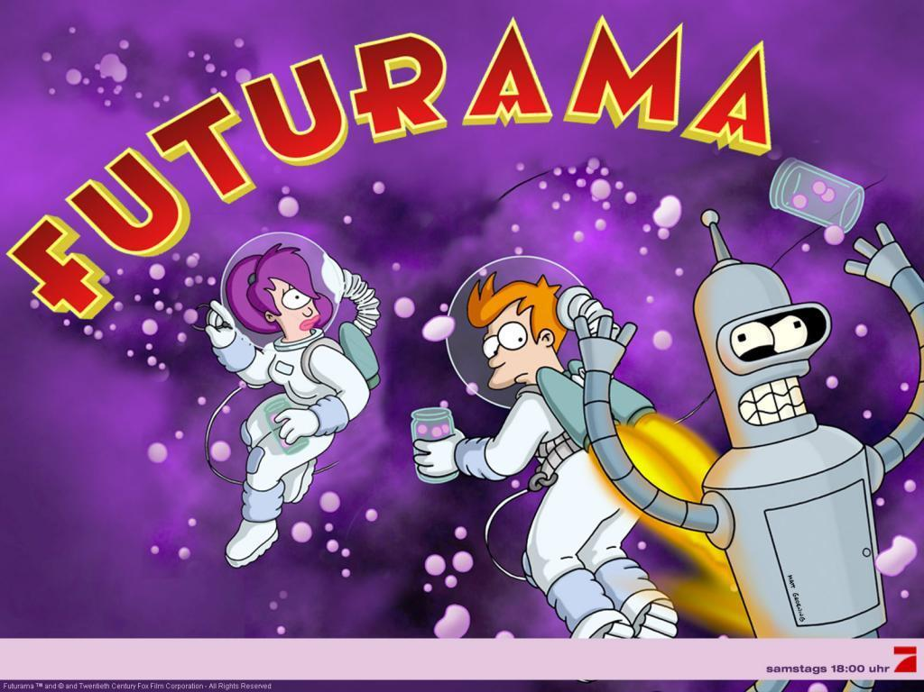

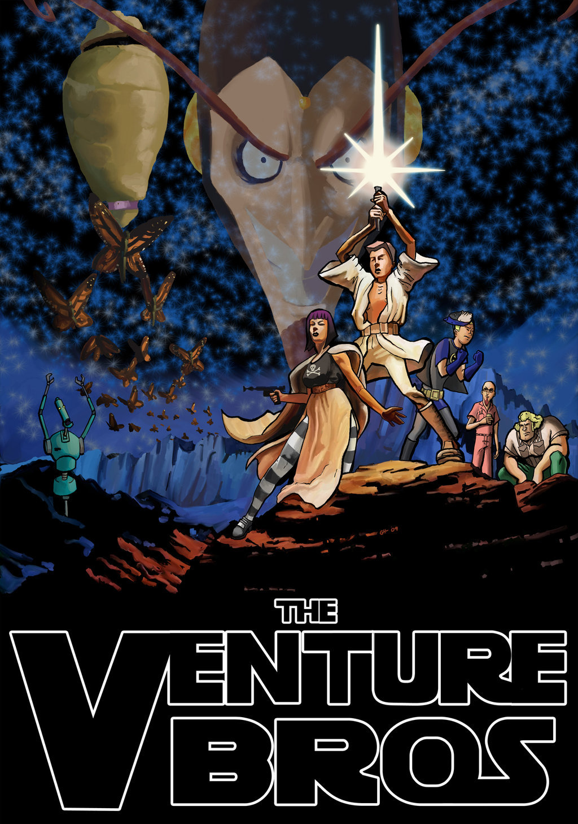



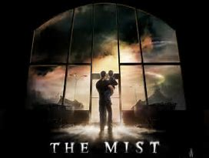




Exemplar Project #3: Discovering a Winning Formula from User Generated Content

Slide 12
PROBLEM STATEMENT
Comedy %?
What are the ingredients for a Superhit Sci-Fi Television Series?
Can User Reviews of TV Series on Social Media be used to find a model that predicts the Success of a New Television Series even before it is aired?
Mystery %?
Action
%?
Thriller %?
Horror %?
History %?
Drama %?
Sci- fi %?
Romance %?
A Superhit Series!
Crime %?

Slide 13



TOPIC MODELING
Sci-Fi
Cast
Cosmic Space
Comedy
Horror
Human & Social
Cast | Cosmic Space | Comedy | Horror | Human & Social Angle
Fan | Science | Funny | Dead | World
Actors | Years | Humour | Evil | Prisoner
Characters | Space | Comedy | Zombie | Blacks
 | Star | Hilarious | Dinosaurs | Woman
 | Time | Cartoon | Blood | Human
 | Mind | Jokes |  | Gay
 |  |  |  | Society
 |  |  |  | Village
 |  |  |  | Power
83% accuracy in predicting hits/flops from content

Slide 14
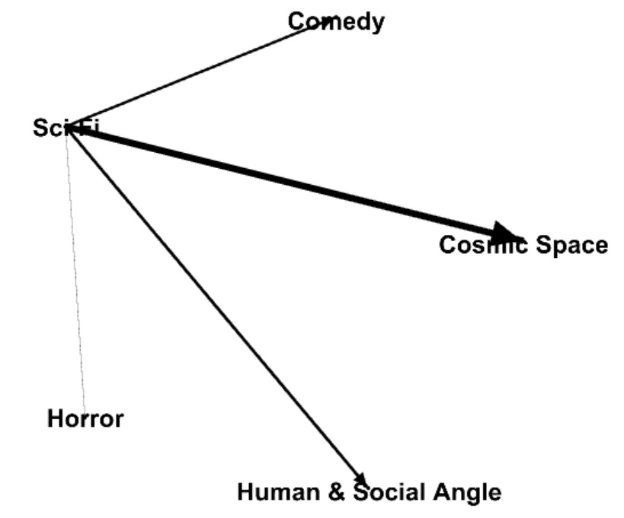
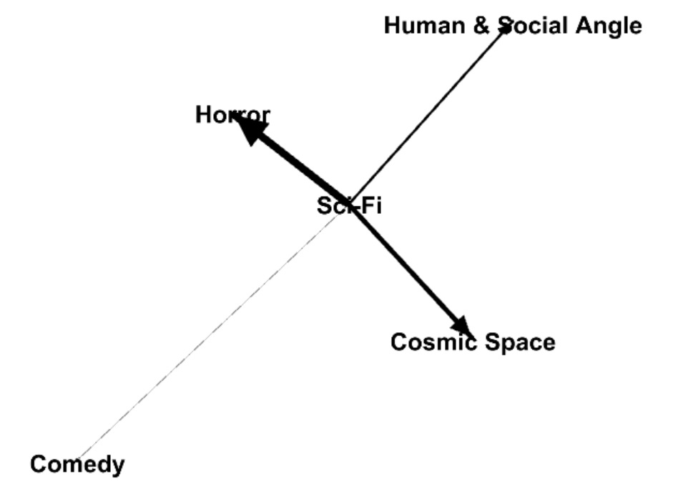
VISUALIZATION USING GEPHI
HITS
FLOPS

Slide 15
Final Project Competition: Key Steps
Collect mentions
Analyze important words, merge
Calculate lifts
Web Scraper, other scripts
Twitter API python script,
Youtube scraper
wordfrequency.py,
Find_and_replace.py
Lift.py
Brand maps
(MDS) mds_new.py
Sample steps only, may differ by project
Topic (e.g., for image analytics)
Business Insights:
Examples (for products)
Real competitors (brands)?
What people talk about
Which attributes matter the most
Which are positive (negative)?
Branding & marketing implications
Sentiment Analysis sentiment.py
Cosine Similarity
Topic modeling
Network Analysis with NodeXL or Gephi
Copyright Anitesh Barua 2018

